Slide 1

Unit 4

Slide 2

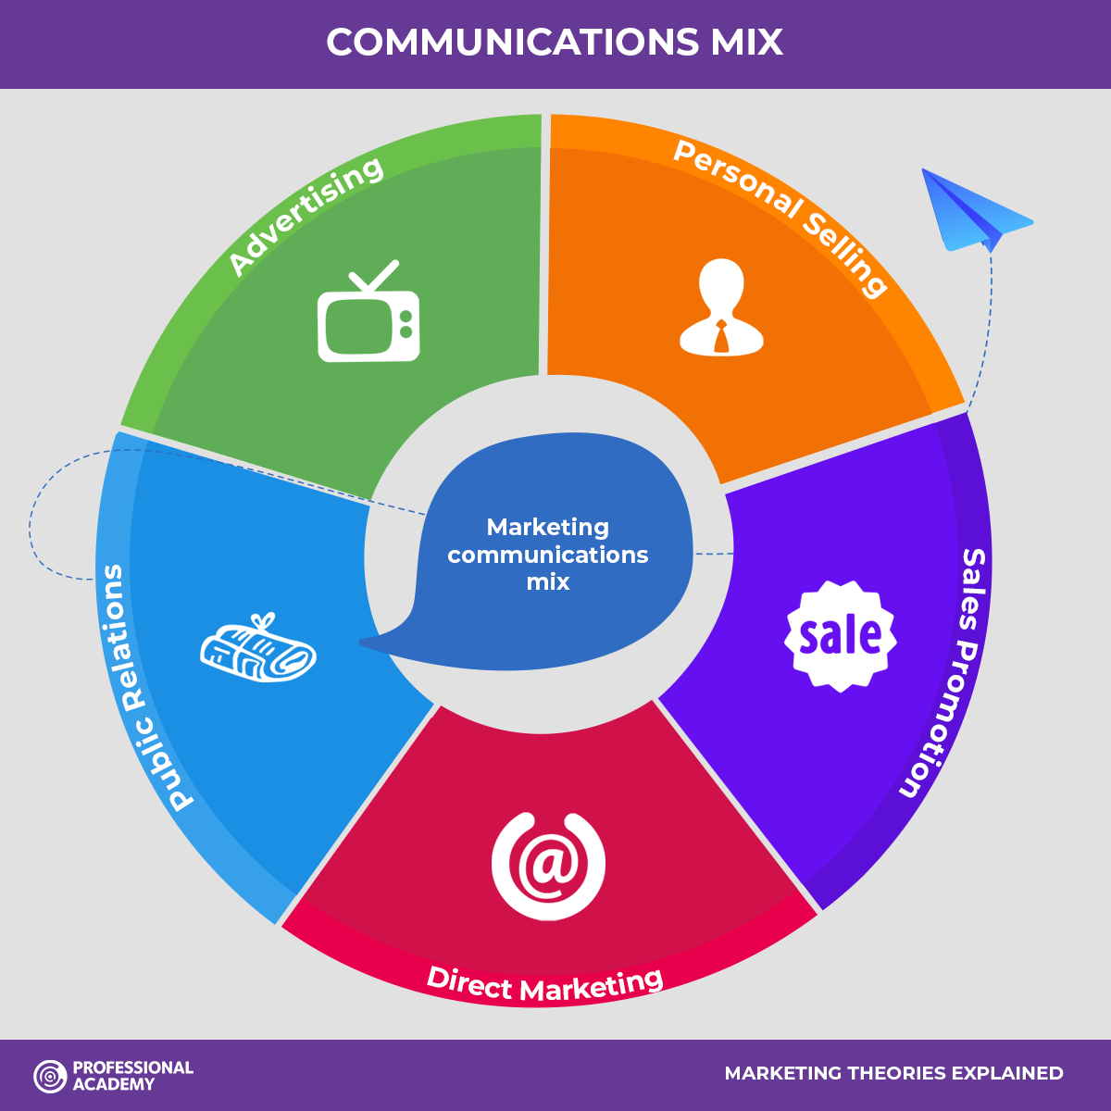

Slide 3
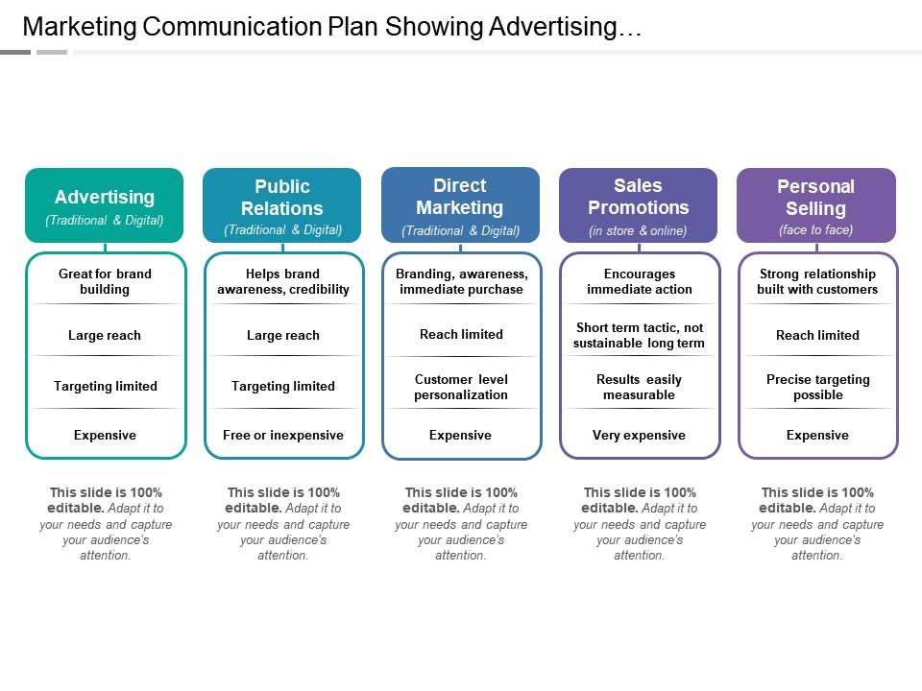

Slide 4
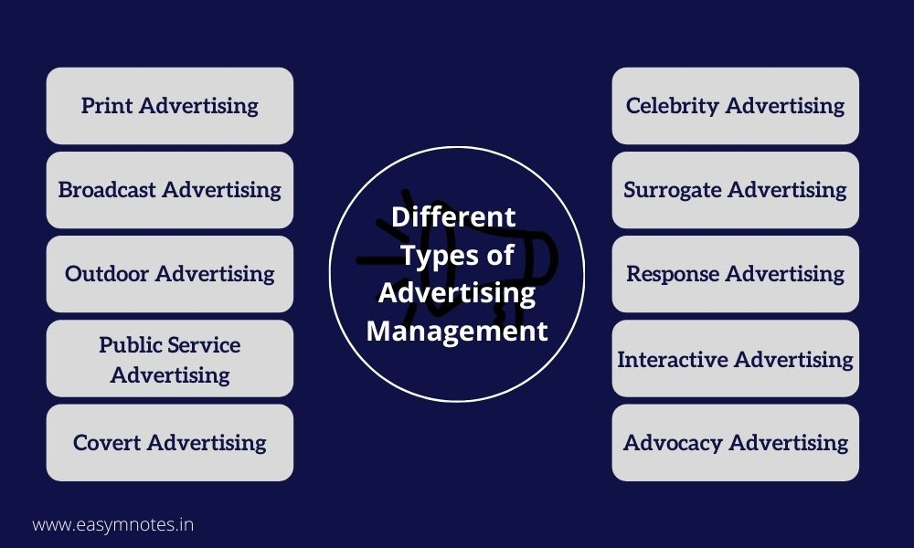

Slide 5







Slide 6

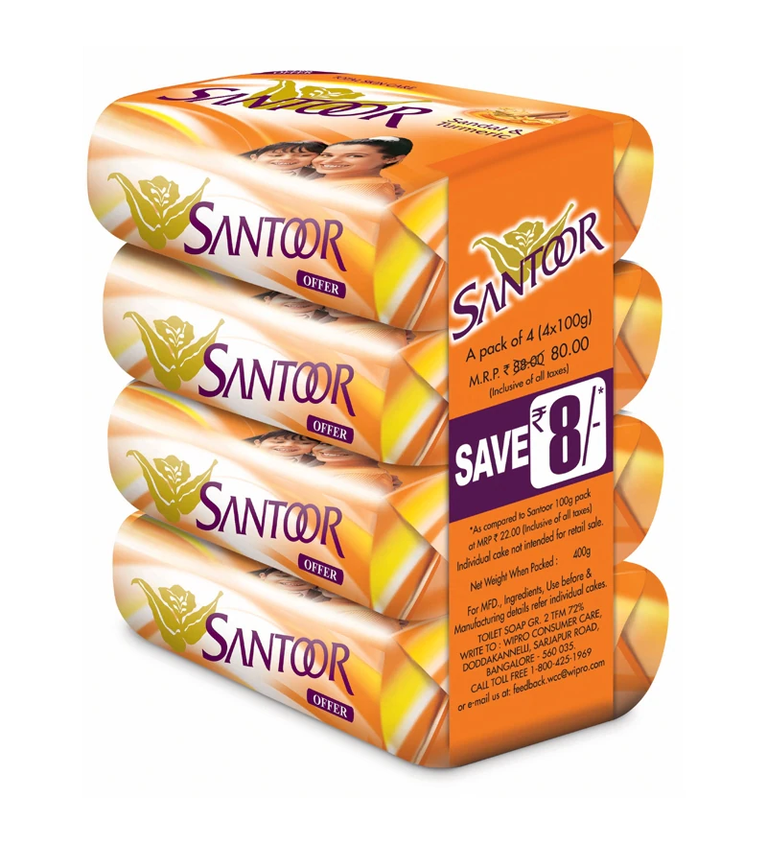
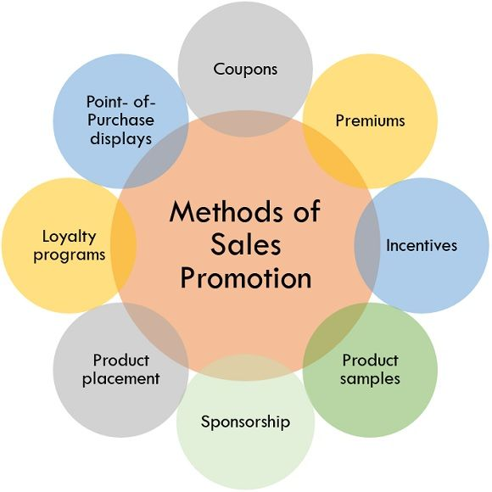



Slide 7
Integrated Marketing Communication (IMC)
The American Marketing Association defines IMC as “a planning process designed to assure that all brand contacts received by a customer or prospect for a product, service, or organization are relevant to that person and consistent over time.”

Slide 8
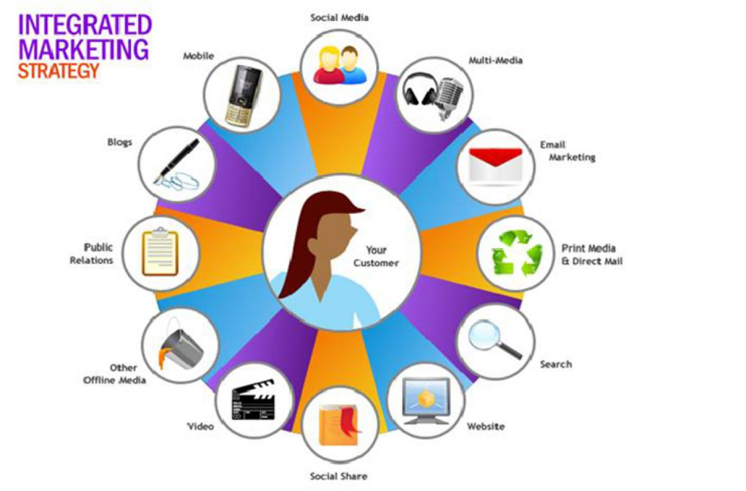

Slide 9

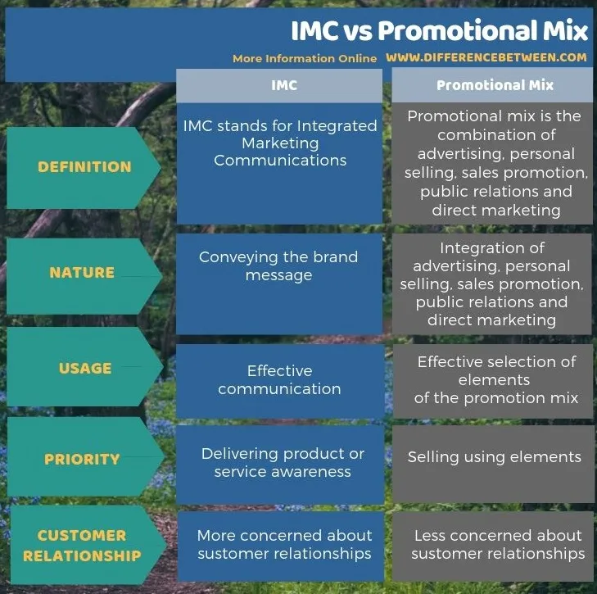

Slide 10

Managing Integrated Marketing Communication
To identify the target audience
Know what you intend to communicate
Carefully design your message
Identify the various channels of communication
Allocate right resources for brand promotion
Measure the results of integrated marketing communication

Slide 12
